Slide 1

Amazon Fresh Analytics
SQL Capstone Project
Domain: E-commerce & Retail Analytics Technologies Used: SQL (DDL, DML, Joins, Subqueries, Normalization) Submitted By: Jatin Sharma

Slide 2
Problem Statement
Amazon Fresh is an e-commerce grocery platform managing:
Customer Data
Product Inventory
Supplier Details
Orders & Transactions
Customer Reviews
The challenge is to design a structured relational database to:
Optimize operations
Improve customer satisfaction
Increase revenue
Generate business insights

Slide 3

Business Objectives
• Identify top customers • Analyze product demand • Monitor supplier performance • Generate revenue insights • Improve customer satisfaction

Slide 4
Dataset Overview
Customers
Products
Suppliers
Orders
Order_Details
Reviews
Each dataset was imported into MySQL and structured using relational design.

Slide 5
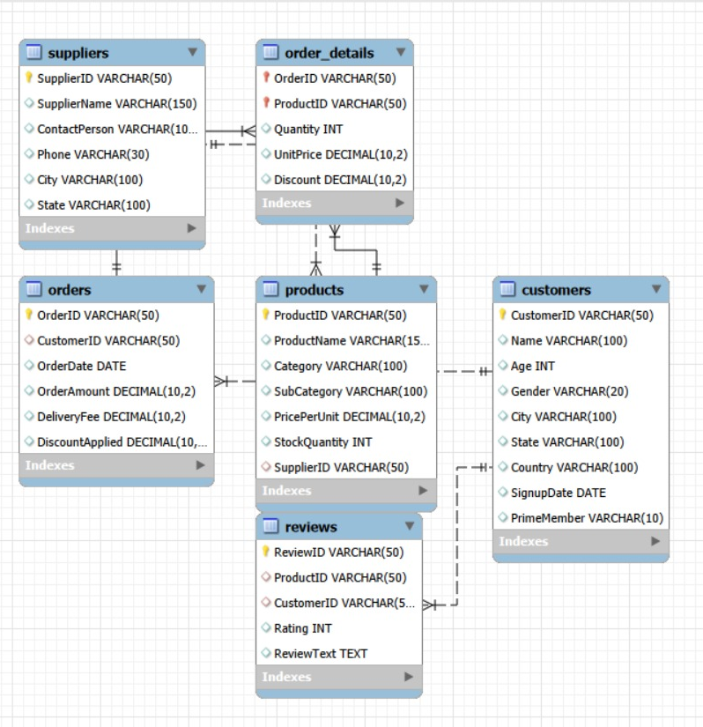
Database Schema (ER Diagram)
Entities:
Customers
Orders
OrderDetails
Products
Categories
Suppliers
Reviews
Relationships:
Customers (1:M) Orders Orders (1:M) OrderDetails Products (1:M) OrderDetails Products (1:M) Reviews Categories (1:M) Products

Slide 6
Database Design & Constraints
Primary Keys defined for all tables.
Foreign Keys implemented to maintain referential integrity.
Constraints Applied:
Age > 18 (CHECK)
Rating between 1–5 (CHECK)
PrimeMember default = 'No'
Unique constraint on Customer Name

Slide 7
Data Manipulation Operations
Performed:
Inserted new products
Updated stock quantities
Deleted supplier records (handled FK dependency)
Ensured data consistency using SQL best practices.

Slide 8

Revenue Analysis
Calculated:
Total Revenue
Revenue per Order
Revenue by Product
Revenue by Category
Identified high-performing products and categories.

Slide 9
High-Value Customers
Calculated total spending per customer
Ranked customers using window functions
Identified customers spending > ₹5,000
Insight: Top 20% customers contribute majority revenue.

Slide 10

Product Performance Analysis
Products with average rating > 4
Top 3 products by sales revenue
Most frequently ordered categories
Helps in inventory planning and promotions

Slide 11
Supplier Analysis
Identified supplier with:
Maximum products in stock
High inventory contribution
Supports supply chain optimization.

Slide 12
Normalization (3NF Implementation)
Original Issue: Category stored repeatedly in Products table.
Solution: Created separate Categories table.
Now: Products → CategoryID (Foreign Key)
Benefits:
No redundancy
No update anomalies
Industry-standard structure

Slide 13
ACID Implementation
Atomicity → Transactions complete fully or rollback Consistency → Constraints enforce valid data Isolation → Independent transactions Durability → Data persists after commit
Ensured database reliability.

Slide 14
Key Business Insights
Cities with highest Prime membership concentration
Top 3 most ordered categories
High-value customers drive revenue
Highly rated products show better sales
Actionable for marketing & inventory strategy.

Slide 15


